Slide 1
COMP 3069
Computer Graphics
Lecture 6:
Projection, Clipping &
Hidden Surface Removal
Autumn 2018

Slide 2
Today’s Content
Recap viewing coordinate system
Projection (orthographic and perspective)
Removing unwanted objects
  Clipping (removing objects that are supposed to be outside the ‘camera range’)
  Face culling (not showing polygons whose vertices are in clockwise order)
  Hidden surface removal (not showing polygons that are hidden behind other polygons)

Slide 3
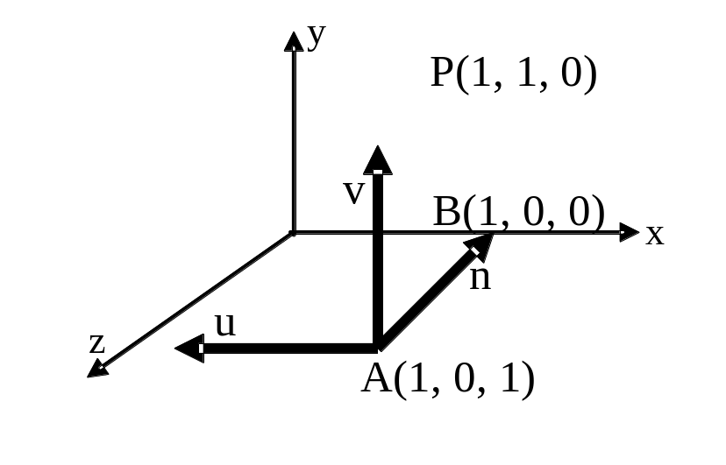
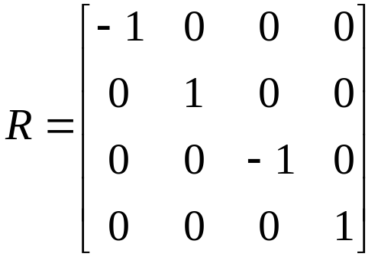
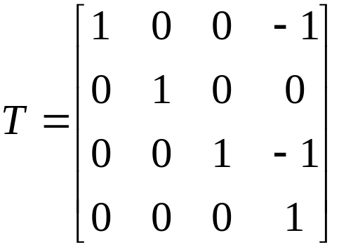
Recap: Viewing/Camera Coordinate System
A viewing coordinate system:
eye at A(1,0,1),
lookat at B(1,0,0),
up is y.
P is in world space.
P’ = R * T * P
T⁻¹ * R⁻¹ * P’ = P

Slide 4
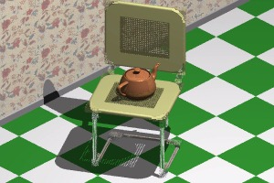
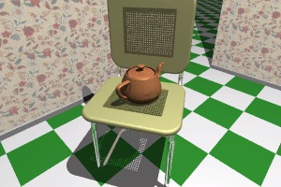
Projection (in View/Camera Space)
Orthographic projection
Perspective projection
Projection in OpenGL
Notes:
3

Slide 5
Projection
We know how to transform objects to View space
We now want to ‘take a photograph’of the objects in the View space – this mapping from 3D to 2D is called projection:
  Parallel projection maps objects directly onto the screen without affecting their relative size, often used in architectural and CAD applications
  Perspective projection gives realistic views, but does not preserve proportions - projections of distant objects are smaller than those near objects of the same size. This is called foreshortening.

Slide 6
Two Common Types of Projections
In Orthographic projection, projection rays are parallel and perpendicular to the view plane:
In Perspective projection, projection rays converge at the observer, or Centre of Projection (CoP)
P₁
P₁
P₁’
P₁’
CoP/
Eye/
Camera
P₂
P₂’
P₂
P₂’
view plane
view plane
Notes:
14

Slide 7
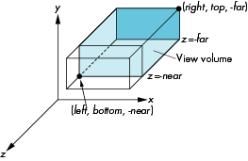
View Volume/Frustum – Defining Regions in Which Objects are Visible
Orthographic view volume is a rectangular block defined by near, far, left, right, top and bottom planes
  OpenGL:
  glOrtho(left, right, bottom, top, near, far)
y_{v}
Q
P
Viewing Frustum
z_{v}
x_{v}
Image Plane
Eye Position

Slide 8
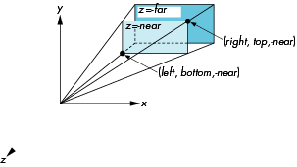
View Volume/Frustum – Defining Regions in Which Objects are Visible
Perspective view volume is defined by field of view or near, far, left, right, top, and bottom planes
  OpenGL:
  glFrustum(left, right, bottom, top, near, far)

Slide 9
View Volume/Frustum – Defining Regions in Which Objects are Visible
Perspective view volume is defined by field of view or near, far, left, right, top, and bottom planes
  OpenGL:
gluPerspective(fovy,
aspect, near, far);
Q
y_{v}
P
z_{v}
x_{v}
Eye Position
Field of view along x (fovx)
Image Plane
Viewing Frustum

Slide 10
Orthographic Projection
Looking at z axis we can see point P on the image plane, which is the projection of a 3D point Q in view space, and x_{P} = x_{Q,} y_{P} = y_{Q} (which means P and Q have the same x, y values)
y_{V}
P(x_{p}, y_{p})
y_{v}
Q
P
x_{V}
Viewing Frustum
z_{v}
x_{v}
Image Plane
Eye Position
Notes:
15

Slide 11
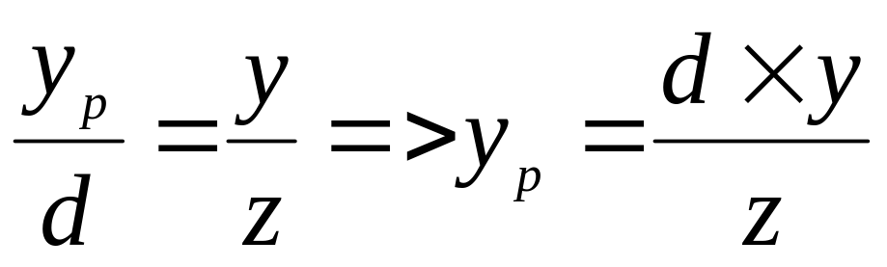
Perspective Transformation Matrix
Looking at X axis, we see similar triangles:
y
P(x,y,z)
P(x_{p},y_{p},d)
o
d
-z
P(x,y,z)
View Plane
y
P(x_{p},y_{p,},d)
d
o
-z
x

Slide 12
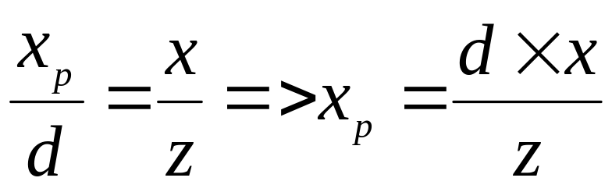
Perspective Transformation Matrix
Looking at -Y axis, we see similar triangles:
P(x,y,z)
X
P(x_{p},y_{p,}d)
o
-z
d
View Plane
x
P(x,y,z)
P(x_{p},y_{p,},d)
d
o
-z
-y

Slide 13
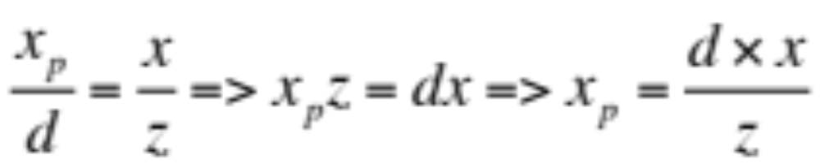

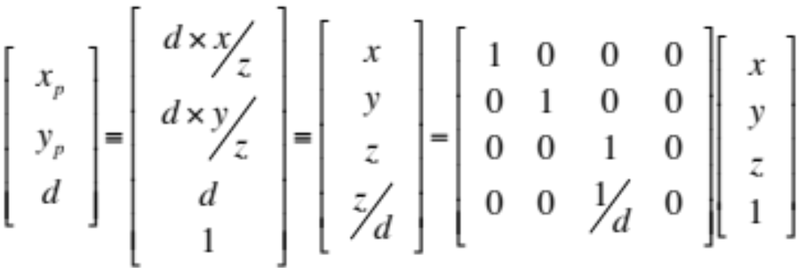
Perspective Transformation Matrix
See next slide …
So in matrix form:

Slide 14
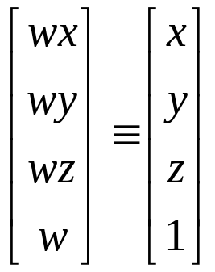
Extending Homogeneous Coordinates to Handle Perspective Projection
When we instroduced homogeneous coordinates, we represent a 3-dimensional point (x, y, z) by the point (x, y, z, 1) in 4D.
Suppose now we represent (x, y, z) by (wx, wy, wz, w) where w≠0.
As long as w≠0, we can recover the 3-dimensional point from its 4D representation by dividing the first three components by w.
In such a generalised represenation, points in 3D becomes lines through the origin in 4D.
With such a representation, we can then use the 4x4 perspective transformation matrix (see previous slide…) to represent perspective projections.

Slide 15
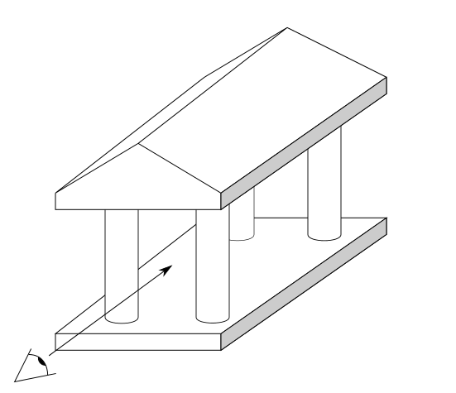
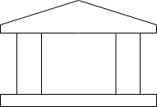
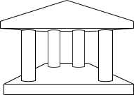
Different Types of Projections
(A) Orthographic
Projection
(B) Perspective
Projection
Viewing direction

Slide 16
Projection in OpenGL
An OpenGL projection matrix takes points in view space and converts them to points in normalised device space or canonical space.
The canonical space is a 2x2x2 cube, centered at the coordinate origin of the view space, with X, Y, Z each ranging from -1 to 1.
Thus only parallel orthographic projection is needed to obtain 2D images of a 3D scene.
Object Space
View Space
Canonical Space
Screen Space

Slide 17
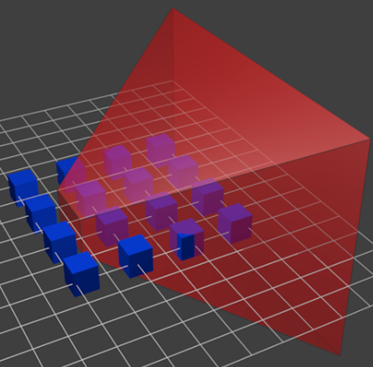
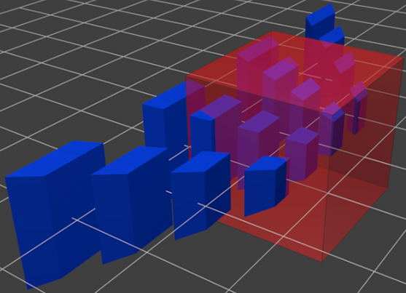
Projection in OpenGL
OpenGL transforms all objects to a canonical space,
  The perspective viewing frustum is transformed to
  the canonical space, and
  All the objects will go through the same transformations

Slide 18
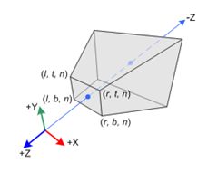
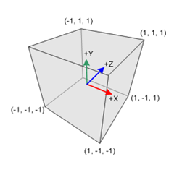
OpenGL Perspective Matrix
OpenGL perspective matrix transforms view frustum in view/camera/eye space to canonical (normalised) space (a 2x2x2 cube):

Slide 19
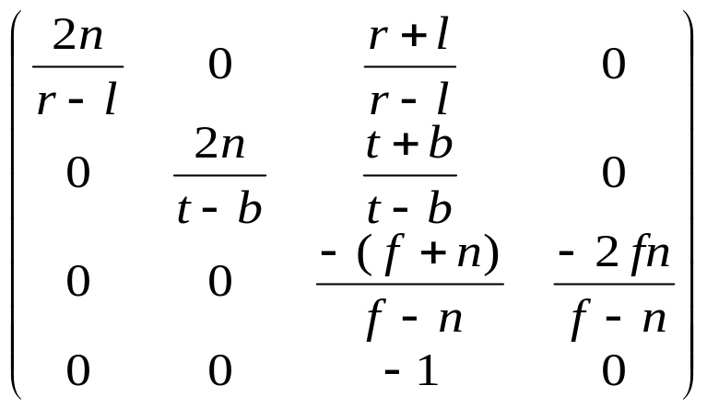
OpenGL Perspective Matrix
Perspective matrix warps objects so that when viewed under orthographic projection, the warped objects appear the same as the original objects viewed under perspective projection
where l=left,r=right,t=top,b=bottom,n=near,f=far.
glMatrixMode(GL_PROJECTION)
y
z

Slide 20
Projection in OpenGL
glMatrixMode(GL_PROJECTION);
glOrtho (left, right, bottom, top, near, far);
gluPerspective(fovy, aspect, near, far);
glFrustum(left, right, bottom, top, near, far);
    glOrtho(-windowWidth/2, windowWidth/2, -windowHeight/2, windowHeight/2, 1, 1000);
    gluPerspective(60.0, windowWidth/windowHeight, 1, 1000);

Slide 21
Canonical to Screen Transform
The last step is to position the 2D image on the display screen by calling glViewport() in OpenGL, to transform canonical coordinates to display coordinates
Parameters of glViewport() describe position of screen space within the window and the width and height of the screen, measured in pixels on the screen
y
screen
x
Notes:
21
21

Slide 22
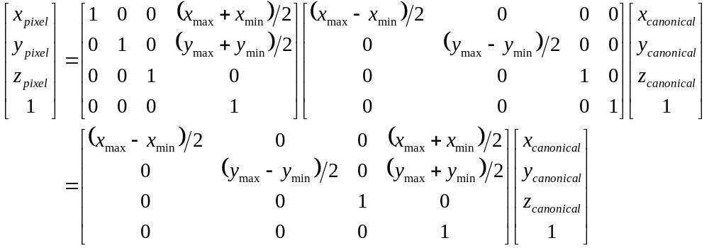
Canonical to Screen Transform
y
(1,1)
y
(x_{max},y_{max})
x
(x_{min},y_{min})
x
(-1,-1)
((x_{min}+x_{max})/2, (y_{min}+y_{max})/2)

Slide 23
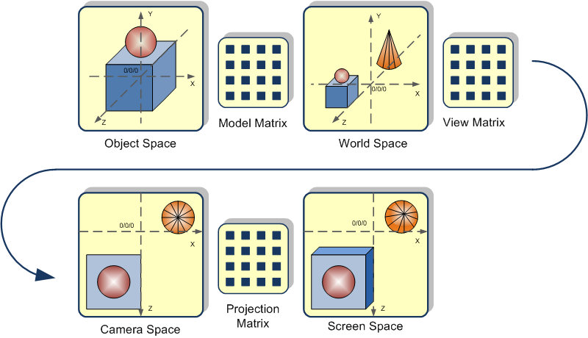
Summary:

Slide 24
Recap for Last Lecture: Projections
(A) Orthographic
Projection
(B) Perspective
Projection
Viewing direction

Slide 25
Today’s Topics:
Removing invisible surfaces : -
  Clipping
  Hidden surface removal
Lighting : -
  How to set up light sources ?
  Flat shading model
  Gouraud shading model
  Phong shading model

Slide 26
Removing Invisible Surfaces
We expect the rendered image to show only the objects within the camera range (inside viewing frustum), and are not blocked by other objects
Clipping allows you to remove objects or polygons outside the camera range
Hidden surface removal allows you to remove objects or polygons that are blocked by other objects

Slide 27
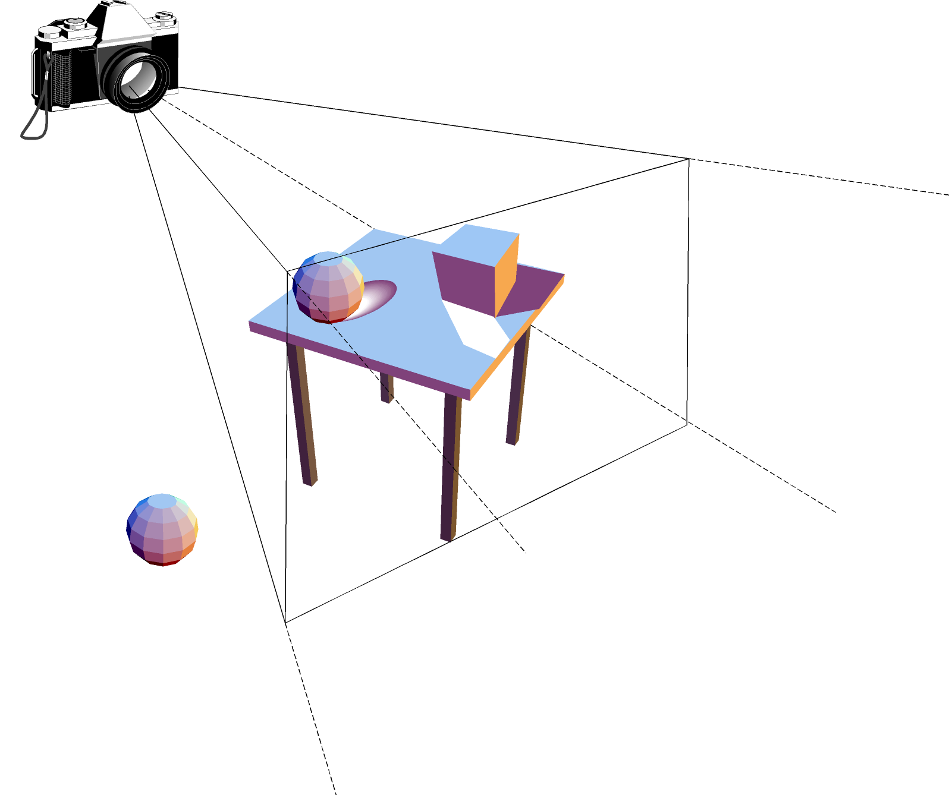
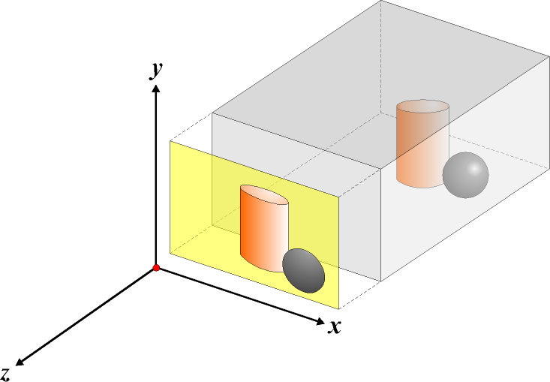
Removing Outside View Surfaces
1. Clipping
view frustum
3d models
viewport
outside view so
must be clipped
2. Hidden Surface Removal

Slide 28
Clipping
view frustum
outside view so
must be clipped

Slide 29
Removing Outside View Surfaces :
Sutherland-Hodgman Clipping
This concerns with polygons - is a polygon (as a list of vertices) inside clip region?
Clip the polygon against each clip plane
Rewrite the polygon one vertex at a time – the rewritten polygon will be the clipped polygon
Clip Top
Clip Right
Clip Bottom
Vertices in
Clip Far
Clip Near
Clip Left
Clipped vertices out

Slide 30
Removing Outside View Surfaces:
Sutherland-Hodgman Clipping
Inside
Outside
Inside
Outside
Inside
Outside
Inside
Outside
d
d
j
c
c
a
a
i
b
b
Output a
Output i
No output
Output j and d
Clip a polygon against a clip plane
  wholly outside visible region - save nothing
  wholly inside visible region - save endpoints
  leave (inside to outside) visible region - save intersection point
  enter (outside to inside) visible region - save intersection and endpoint

Slide 31
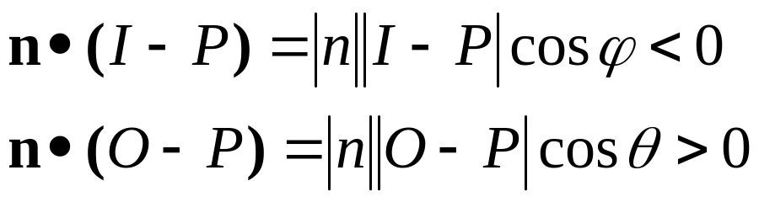

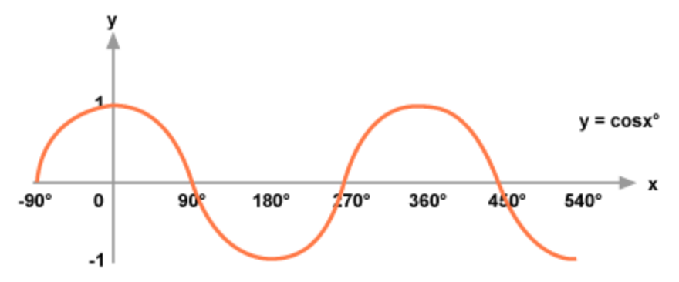

Inside-Outside Testing
Clipping line/plane has a normal vector pointing toward the outside of the clip region.
The sign of dot product gives inside/outside information of the point.(–ve: inside; +ve: outside)
Graph of cos() function:
inside
outside
n
P
O
I
P is any point on
the clip line/plane

Slide 32
Hidden Surface Removal
3d models
viewport

Slide 33
Hidden Surface Removal
To speed up the rendering process, we need to identify polygons that are not visible, e.g., hidden behind other polygons so we do not render them.
Object based methods – compare each polygon with the rest of polygons. Complexity is O(k²), where k is the number of polygons.
Image based methods - consider a ray that leaves the center of projection and passes through a pixel and decide which polygon should appear at the pixel and what colour/light/texture the pixel should be.

Slide 34
Polygon Winding Order
Winding defines the relative order in which the vertex points of a polygon are listed.
When the user issues a drawing command, the vertices processed are processed in the order provided by vertex listing, which can be either clockwise or anticlockwise.
Polygons with vertices in anticlockwise order are considered to be on the outside of object.
Polygons with vertices listed in clockwise order are considered to be on the inside of object.

Slide 35
Polygon Winding Order
From view point:
Anticlockwise: 4,3,2,1
glVertex3f( 1, -1, 1 );
glVertex3f( 1, 1, 1 );
glVertex3f( -1, 1, 1 );
glVertex3f( -1, -1, 1);
From view point:
Clockwise: 1,2,7,8
glVertex3f( -1, -1, 1);
glVertex3f( -1, 1, 1 );
glVertex3f( -1, 1, -1 );
glVertex3f( -1, -1, -1 );
y
7
-1,1,-1
2
6
1,1,-1
-1,1,1
3
1,1,1
8
o
-1,-1,-1
1
5
-1,-1,1
1,-1,-1
x
z
4
1,-1,1

Slide 36
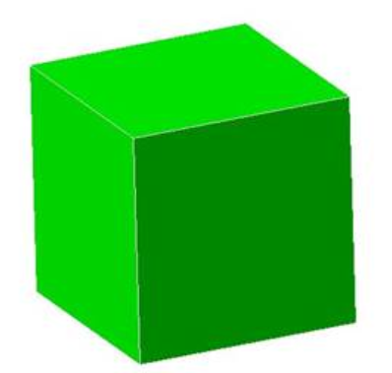
Hidden Surface Removal -
Face Culling
Face culling allows non-visible polygons to be removed before expensive rasterization and/or other operations.
To activate face culling, GL_CULL_FACE should be enabled (by default, face culling is disabled).
glEnable(GL_CULL_FACE)
To select which side of the face will be culled, use
glCullFace (mode) - where mode​
can be set to GL_FRONT, GL_BACK,
or GL_FRONT_AND_BACK.
By default, GL_BACK is the face to
be culled.

Slide 37
Hidden Suface Removal Methods
The method we have just seen is an
object / geometry-based method.
Next we introduce another kind of method:
  called image-based method for performing hidden surface removal, which is called z-buffer technique … (see next slide …)

Slide 38
Removing Hidden Surfaces –
Z Buffer Algorithm
Z-buffer is a block of memory the same size as the image.
Each position in the z-buffer corresponds to an image pixel and stores the z value of the polygon found to be closest to the pixel
This is because we want the 2D image formed on the image plane to have the same colour as the polygon closest to the image plane
To enable hidden surface removal in OpenGL: call glEnable(GL_DEPTH_TEST);

Slide 39
Removing Hidden Surfaces –
Z Buffer Algorithm
  Consider a ray that passes through an image pixel P.
  Calculate the depths (z values) of polygons that the ray hits.
  Compare these depths with the value stored at P in the z-buffer: if a depth value is smaller (polygon nearer to image plane) than the value at P in the z-buffer, replace the value in the z-buffer with this value, and colour the pixel with the colour of the polygon at this depth.
frame buffer
A
B
P
x
P
Replace depth value at the same
place in frame buffer with the depth value of the blue square
z_{new}
z_{old}
z
y

Slide 40
Removing Hidden Surfaces –
OpenGL Code for Z Buffer
Enable hidden surface removal in OpenGL: call glEnable(GL_DEPTH_TEST);
You also need clear the depth buffer glClear(GL_COLOR_BUFFER_BIT|GL_DEPTH_BUFFER_BIT);
otherwise, the old values of dept buffer remain.

